Slide 1
Interpretable Machine Learning

Slide 2
Agenda
Jessie
Causal Example
Interpretable Machine Learning implementation
Neural Network model (fail example, extract features from image data set)
Causal AI implementation

Slide 3
Why identifying causal relationships in healthcare is important?
Jessie

Slide 4
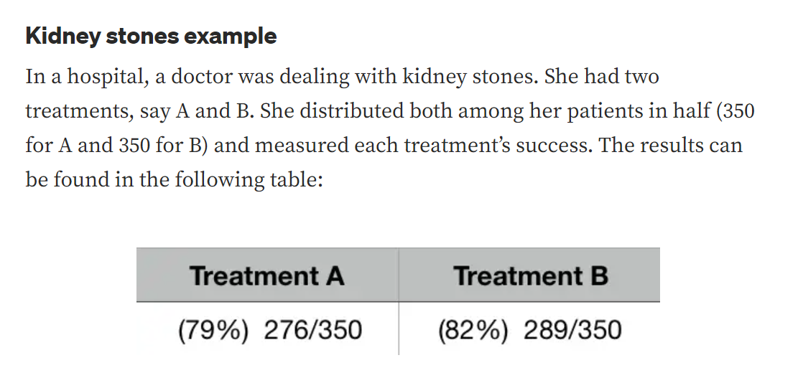
Simpson’s Paradox
Jessie

Slide 5
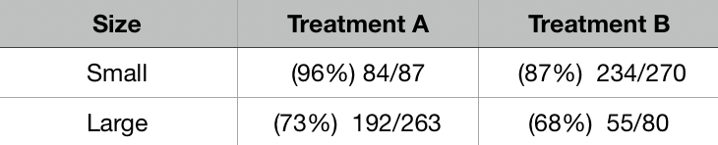
Jessie
For small stones A is better, for large stones A is better; but aggregated result, B is better.
What the ……
What’s going on????

Slide 6
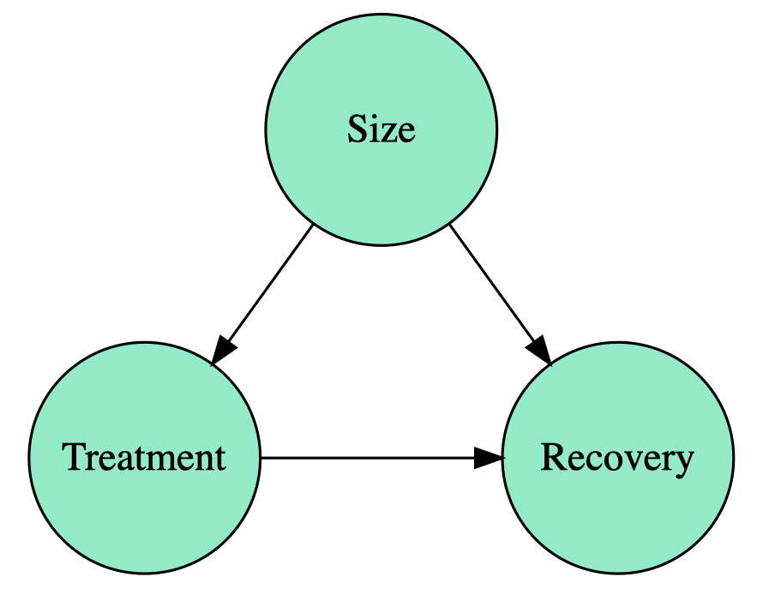
Jessie
How had patients been assigned to different treatments?
Treatment A: surgery
Treatment B: pill
Giving pills to large stones was less effective, so patients that have larger stones were assigned to treatment A.
The size affects both the treatment assignment and the chances of recovery. The size is a confounding factor since we cannot distinguish the effect of treatment and the effect of size on recovery.

Slide 7
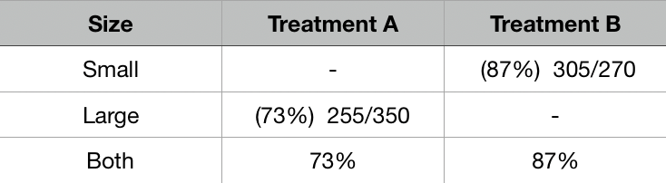
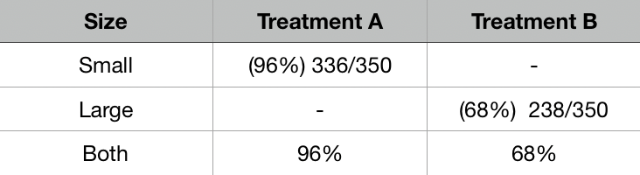
Extreme Assignment
Jessie

Slide 8
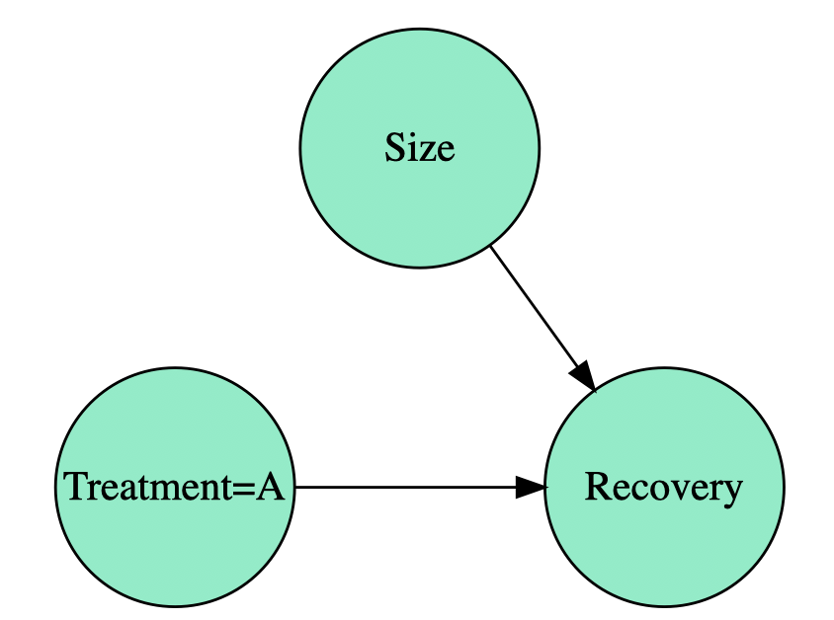
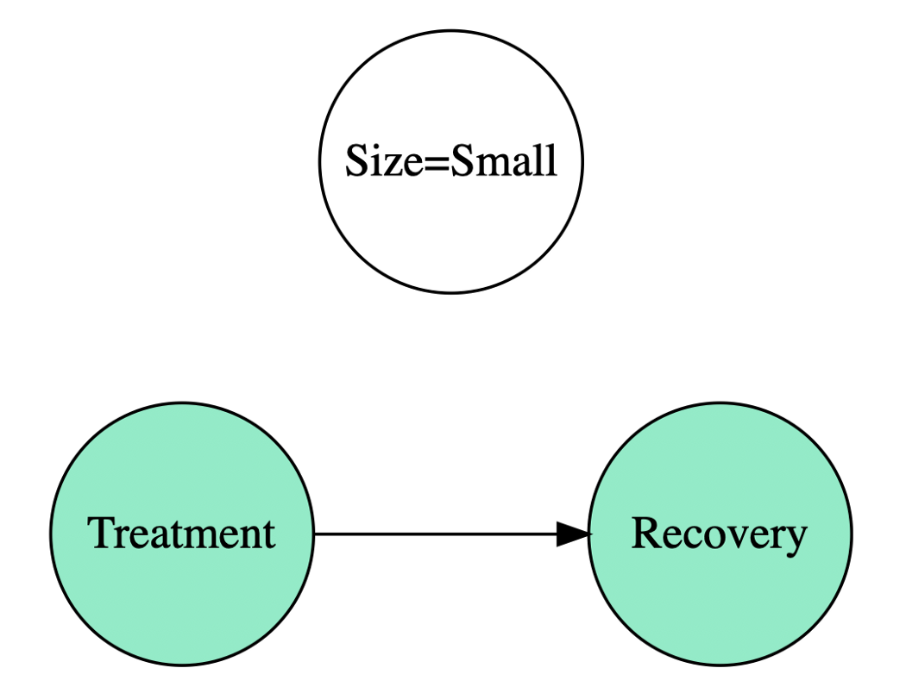
Intervention
Jessie
What if the hospital had to choose only one treatment, which treatment should it choose?

Slide 9
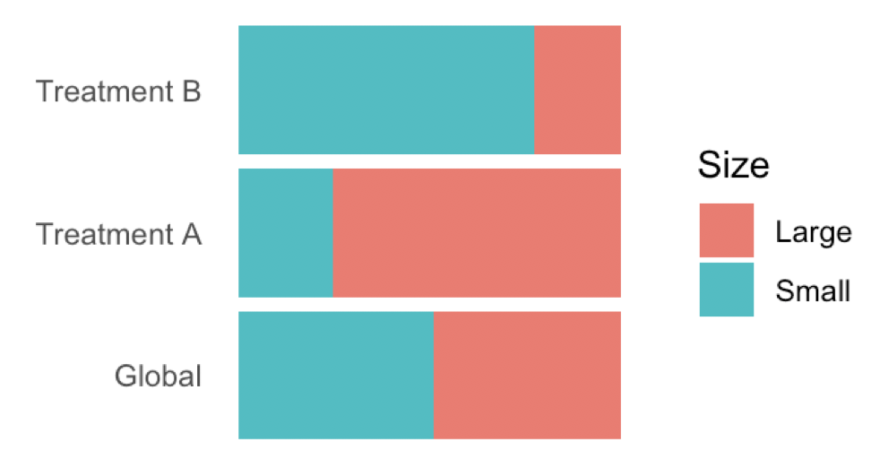
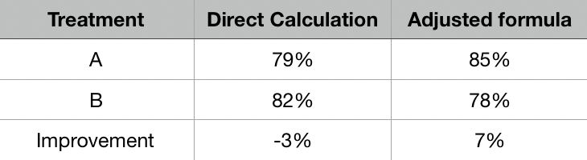
Adjusted Formula
P(R|A) = P(R|Small, A) * P(Small) + P(R|Large, A) * P(Large)
Jessie
Direct calculation may bring wrong conclusions.
Correlation is not enough since it’s bidirectional while causation has a clear directionality.
Different models lead to different conclusions, so we need to carefully decide when and when not to apply adjusted formula.

Slide 10
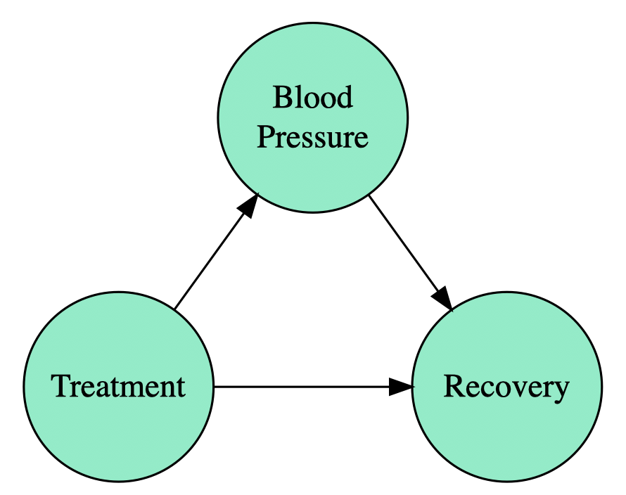
There are situations where adjustment will bring to wrong conclusions
Jessie
Now treatment has a direct way and an indirect way to affect your recovery. But you are interested in both! You don’t want to remove any effect from it. The idea is that in this case, you don’t need to apply any adjustment because the direct measurements will give you the right quantity.

Slide 11
Why drawing causal relationships is important in Healthcare? When is causal relationship important?
Jessie
RCT could be unethical
Randomized trial → poor generalizability (RCTs can only test a few bundled intervention at a time)
Differential Diagnostics is hard (there are multiple possible causes of a patients symptoms)
precision medicine: prediction + intervention
Predicting risks and outcomes differs from weighing interventions and intervening. Prediction calculates a future event in the absence of any action or change; intervention presumes an enacted choice that may influence the future, which requires consideration of the underlying causal structure.
With domain knowledge of the variables involved in a hypothesized cause–effect route and enough data generated at random to cover all possible path configurations, it is possible to deduce causal effects and calculate counterfactuals. Randomization and domain knowledge are key: when either is not met, causal inference may be flawed⁵.
Notes:
Intervention imagines how the world would be if we made different choices
for example, ‘would the patient be cured if we administered amoxicillin instead of a cephalosporin for their upper respiratory tract infection?’ or ‘if a pre-hypertensive patient had accomplished 10–15 min of moderate physical activity per day instead of being prescribed a diuretic, would they have become hypertensive five years later?’

Slide 12
What to consider for implementation
AUC recall (detection)=TPR (The cost of type I error is way lower than the false negative rate)
Stakeholders opinions (hospital vs. personal)
Eva

Slide 13
Existing IML methods
Eva
What’s fall short?
Not statistically rigorous (no confidence interval)

Slide 14
General classification models (Interpretable)
Eva
Interpretable in a way that we know how the models work
Observe the associations between features and output

Slide 15
knn
Eva

Slide 16
Decision tree
Eva

Slide 17
Random forest
Eva

Slide 18
Ensembled model
Eva

Slide 19
Skater Implementation (IML methods)
Eva
Feature importance
Partial dependency plot

Slide 20
Global Interpretation
Eva
Permutation Feature Importance
Partial Dependency Plot
The biggest pitfall
Can be biased by unrealistic data instances

Slide 21
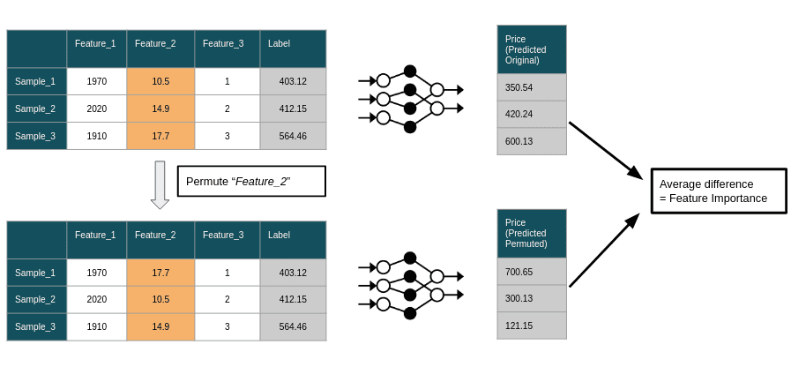
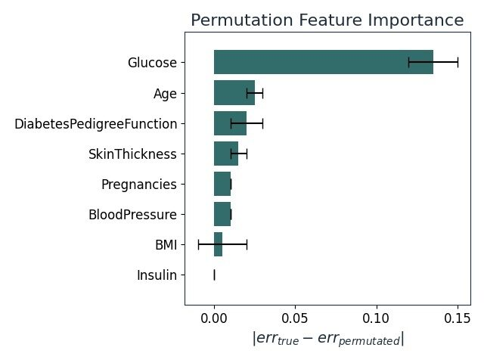
How Permutation Feature Importance Works
Eva
Source: https://www.modulos.ai/blog/permutation-feature-importance-deep-dive/

Slide 22
Permutation Feature Importance
Eva
How it works:
For each feature, permutation feature importance measure the effect that shuffling of its values has on the model’s prediction error. If the shuffling of a feature increases the model error, a feature is deemed important by this measure.
Advantages:
Nice interpretation (intuitive)
Comparable across different problems
Disadvantages:
Linked to the error of the model
Need to access the true outcome to calculate prediction error
Result might vary greatly because of shuffling
Can be biased by unrealistic data instances
Adding a correlated feature can decrease the importance of the associated feature
Notes:
A feature is “important” if shuffling its values increases the model error, because in this case the model relied on the feature for the prediction. A feature is “unimportant” if shuffling its values leaves the model error unchanged, because in this case the model ignored the feature for the prediction.
Source: https://christophm.github.io/interpretable-ml-book/feature-importance.html
(2) https://www.modulos.ai/blog/permutation-feature-importance-deep-dive/
When we work with Machine Learning models, we often report the model’s score: accuracy 0.9 or R square 0.85. These performance metrics are easy to understand and practical when comparing the performance between different models. Unfortunately, they reduce the complexity of the model to a single number. which cannot be answered with these single numbers. For example: “Which of my input features is the model relying on to make predictions?”, “Are those predictions trustworthy even for unseen data instances?” or “My model is performing exceptionally well/poorly. Did we make mistakes when preparing the input data?”

Slide 23
The limitation of feature importance
Eva
For feature importance, you kind of measure how well your model performs and then you measure again after you shuffle one of the features. You need to understand what happens when you shuffle the feature. You kind of break the association between the feature and the prediction because now it doesn’t carry the information about the target anymore. Because you’re shuffling it randomly in the model. So the feature importance now measures how much performance you lose because of this break of information. But you also need to understand that the shuffling also breaks the association with your other data. This is the limitation of the method. I think what is needed is that we understand in which way this methods break or in which scenarios we are allowed to use them or how we are allowed to interpret them. The situation is kind of similar to statistics where you have models and then you interpret the coefficient of the models. You still need to learn how to do the interpretation and what are the assumptions that need to be met that you’re allowed to make this interpretation.

Slide 24
Partial Dependence Plot
Eva
Notes:
Source: https://www.youtube.com/watch?v=uQQa3wQgG_s (Partial Dependence Plots (Opening the Black Box)
Where this comes in really handy is you being a data scientist or statistician who understands some models pretty well and you have to convey those results about how your model works and why it does what it does to other people in your organization or others who might be not have much experience in data science or statistics to understand the mathematics of these models.
As a data scientist, we are not just concerned how the model works. But at the end of the day, we need to take our results and package them in such a way that people who maybe aren’t as data savvy can understand.
Give an example:
Let’s say if the model is doing well by whatever metrics you’re choosing (accuracy, precision, recall) whatever, and we bring this model to the board to decide whether or not to use it for some purposes. However, they’re very skeptical as they should be because they don’t quite understand how the model works. Can you tell us how each features affects the final predicted probability. Humans have kind of natural skepticism towards letting machine do the deciding, so we need to feel comfortable about how the machine is doing the deciding and that’s where the partial dependence plot comes in.
Process:
How does a feature affect the final classification.
Step1: The first step is to artificially set the values0 of a feature to zero.
Step2: Calculate the predicted classification of each of the sample. And take the average of predicted values.
This is basically saying that in a population of people who haven’t got pregnant before (because we artificially set that to be so, what is the average predicted values)
Step 2 will be repeated over all the possible value of the feature we are looking at.
Step 3: Create partial dependency plot
Disadvantages:
The approach assumes that the features are independent. (weight vs. height), we might artificially create a data set that probably can never exist in the world.
Taking the average of all the predicted outcome. However, the average will blur out some of the important deviation

Slide 25
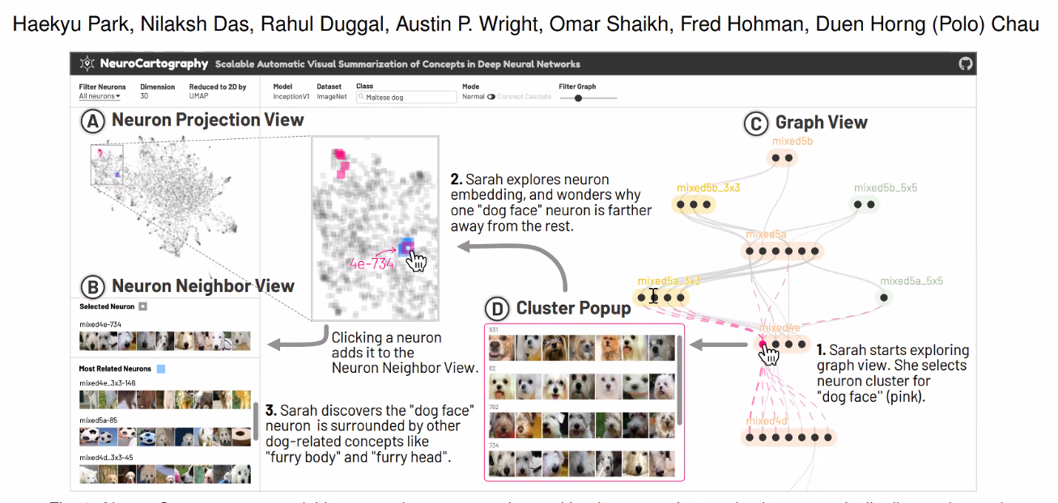
Neural Network Interpretation
Aki

Slide 26
Causal AI Implementation
Aki
Relies on “expert knowledge”
Expert knowledge will affect the accuracy of the causal inference

Slide 27
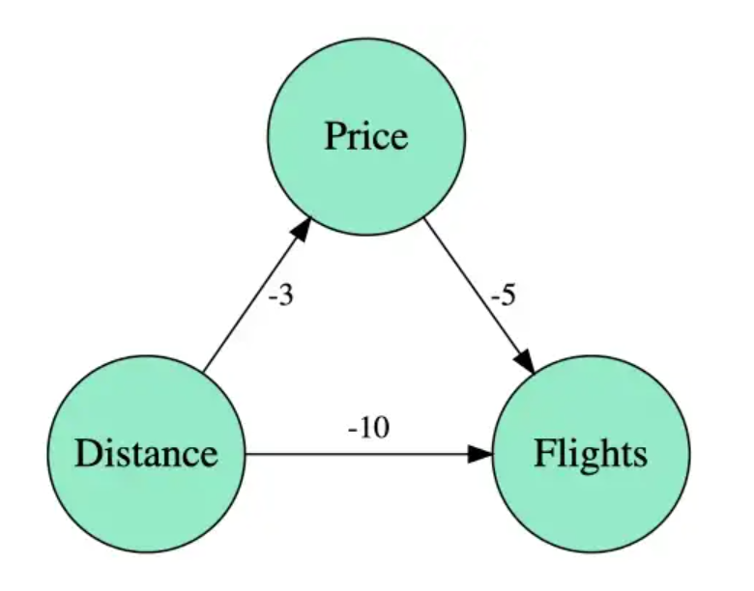
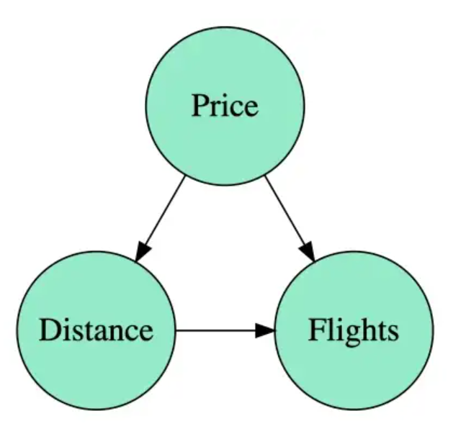
Causal Graph
Aki
The way data is generated and how we model this process is really important. Moreover, this knowledge does not come from data, but from the particular domain itself.
Source: https://towardsdatascience.com/use-causal-graphs-4e3af630cf64

Slide 28
Conclusion
Aki
What good explanation looks like
Interpretability → there are still a lot of pitfalls
Interpretability is the prerequisite for explanability
Context, domain knowledge→ to achieve explanability

Slide 29
Aki
It’s really easy to access machine learning models because we have benchmarks and we have true labels. But we can’t really quantify how correct an explanation is and it doesn’t really help there is taxonomy. And you need to have technical knowledge to understand these assessments.
I’d like the idea about thinking the process rather than thinking about just the model. We need to have a holistic view of the entire process. We need to think aobut how we explain predictions to folks from diverse backgrounds. How do we have interpretability at the societal level or at the institutional level. Thinking more broadly than at the moment. We need to reach out to other disciplines such as psychologists and social scientists.

Slide 30
What a good explanation is?
Aki
What we can learn from the social sciences about what a good explanation is. They should be contrastive. They should be short. But they should also confirm to some prior knowledge that the people have. A lot of things that you wouldn’t say are good explanations in some sense. Maybe it’s not a good explanation that fits the priori knowledge. Because it’s not the correct one maybe. It’s important to think about the human side of it.
What we really want after explanation?
We need to be careful about what information is lost when making an explanation (explanation: mapping the higher dimensional information to lower dimensional)

Slide 31
Aki
Going to the direction of automatic machine learning. You don’t just get the best performing one but you have this pareto set. We have multiple objective you want to hit then there’s not one model that works the best but you have a set of models that have different trade-offs between these objectives and then you have to decide what is the trade-off that you want to make

